Slide 1
Multiple Linear Regression
Mark Tranmer, Jen Murphy, Mark Elliot, Maria Pampaka
Written by the authors. Narrated by AI voiceover.
Full resource, see: https://www.ncrm.ac.uk/resources/online/all/?id=20848

Slide 2
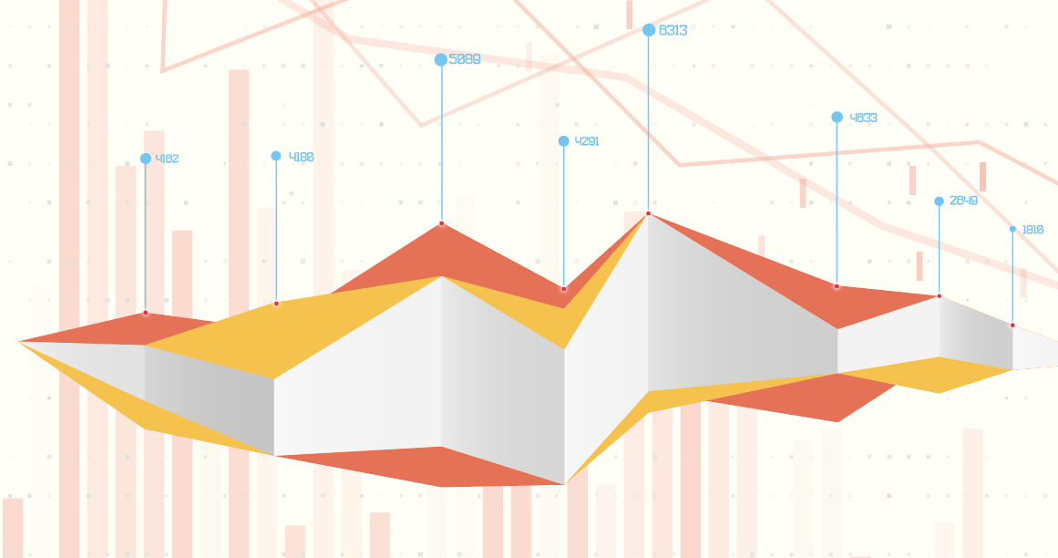
Introduction to Multiple Linear Regression
A statistical modelling
technique to analyse and
predict relationships
between variables.
MLR helps understand the
relationship between one
dependent variable and
two or more independent variables.

Slide 3
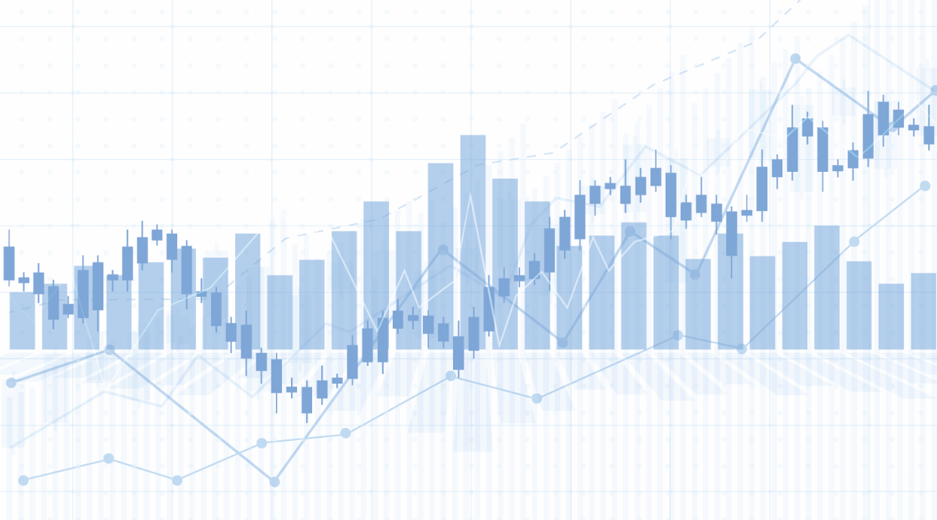
Overview
Explore MLR with examples
from social sciences.
Downloadable worksheet and
are also workbook available.

Slide 4
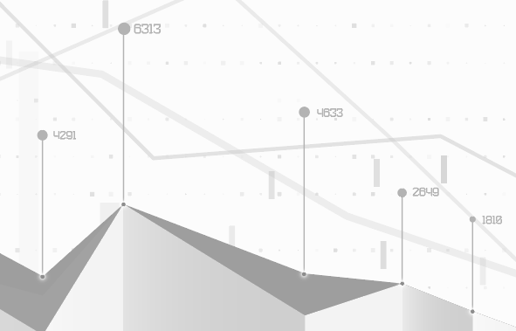
Foundations of MLR
MLR builds on simple linear regression.
It explores the effect of multiple independent variables on one dependent variable.

Slide 5
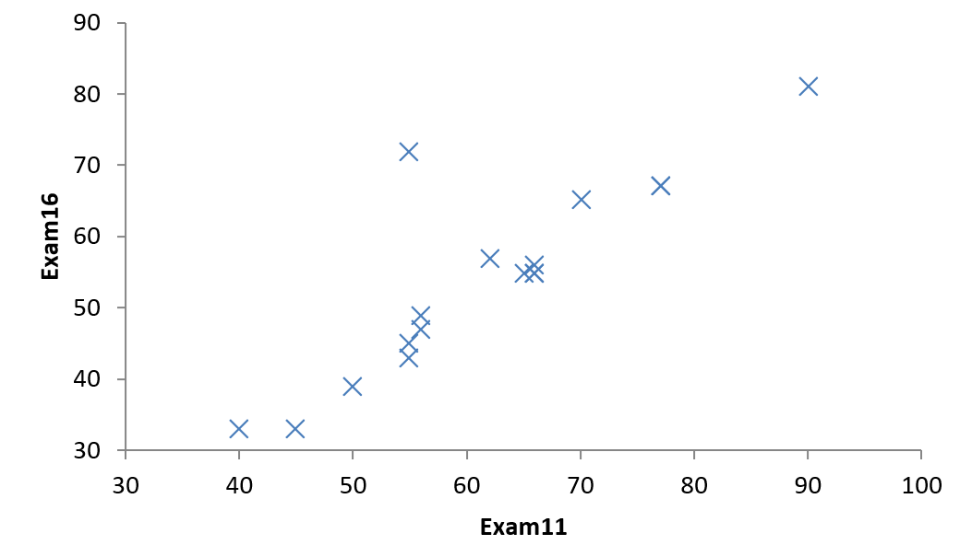
Simple Linear Regression
Estimates the relationship between a response variable (y)
and a single explanatory variable (x).
Example: Predicting exam performance at age 16 based on
exam results at age 11.
Scatterplot of exam score at age 16, against score at age 11

Slide 6
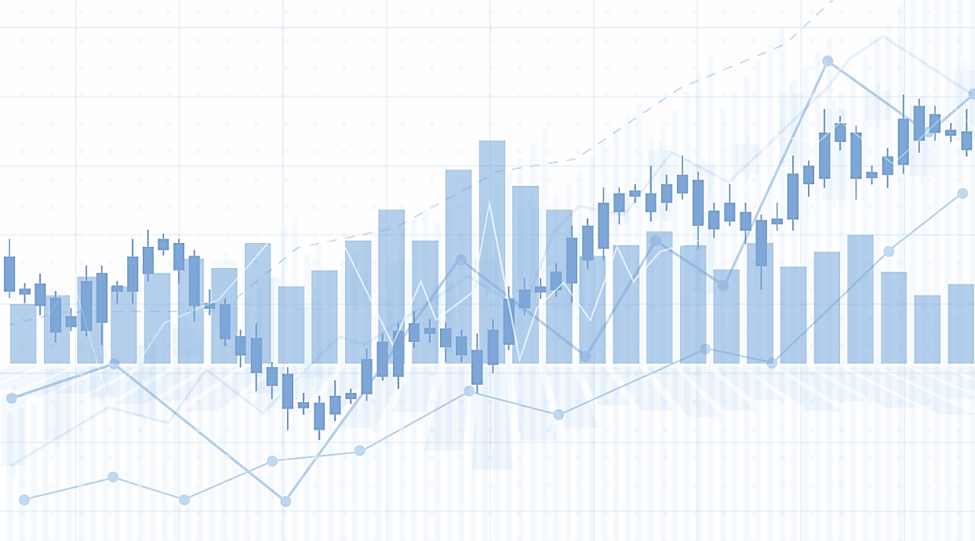
Multiple Linear Regression
Extends simple linear regression to include more explanatory variables.
Still assumes the relationship between variables is linear.

Slide 7
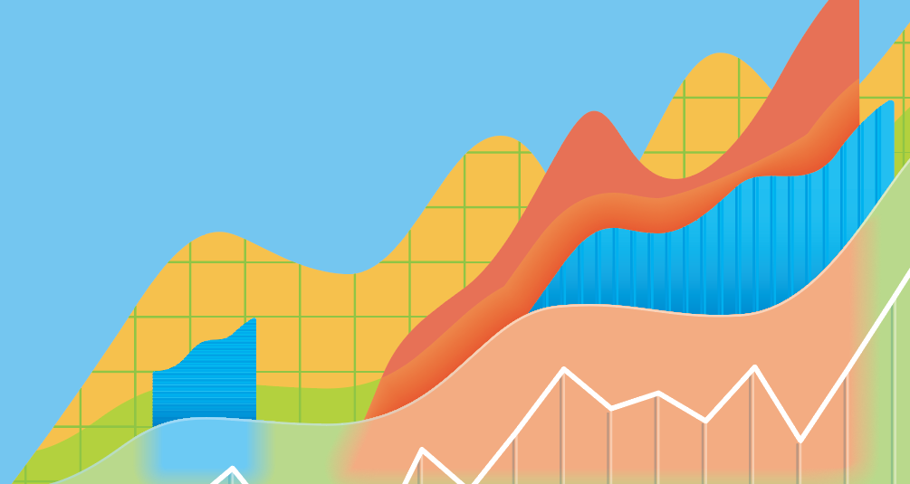
Practical Examples
Predict income using socio-economic characteristics.
Estimate blood pressure considering factors like occupation, smoking,
age, etc.

Slide 8
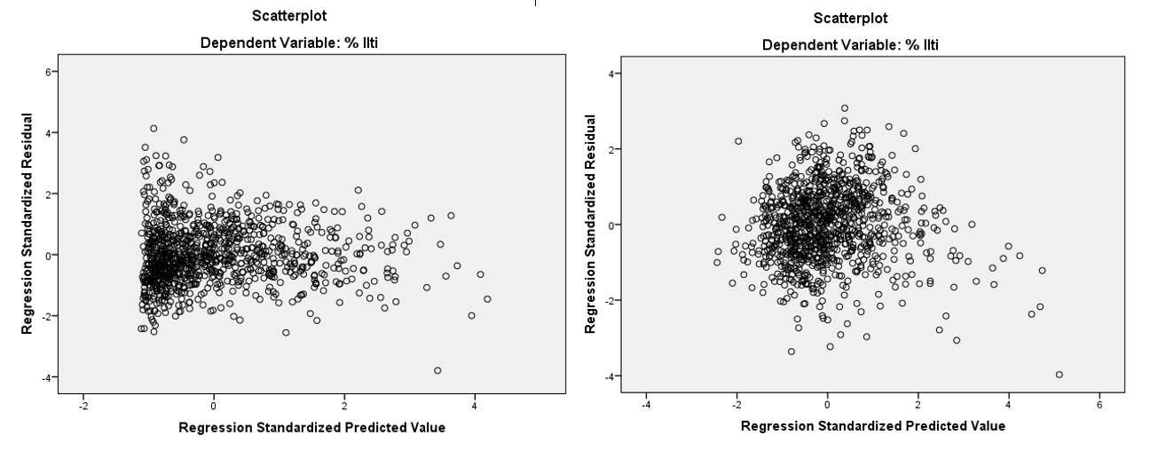
Assumptions of MLR
Homoscedastic residuals
The response variable is continuous.
The relationship between variables is linear.
Residuals are homoscedastic and normally distributed.
Limited multicollinearity between variables.
No extrinsic variables.
Errors and observations should be independent.
Heteroscedasticity:

Slide 9

Dealing with Assumption Violations
If assumptions are violated, adjustments to the model or interpretation may be needed.
In some cases, data
transformation might be required.

Slide 10
www.ncrm.ac.uk

